Slide 1
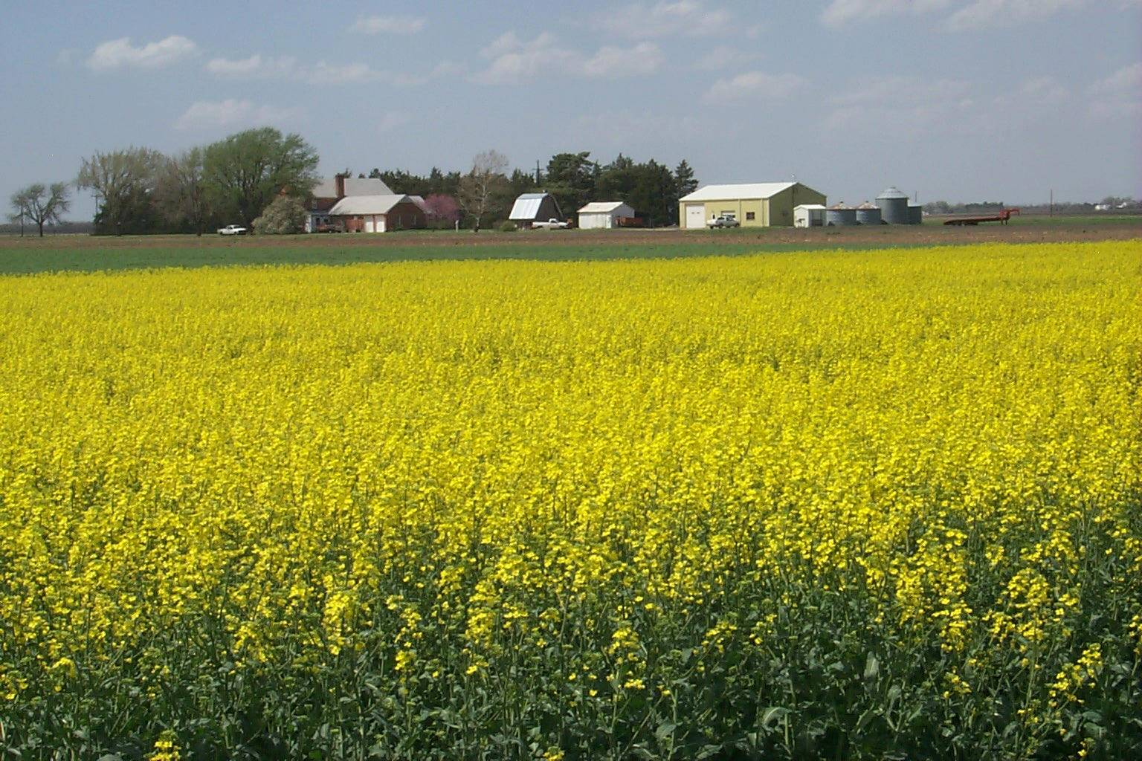
Canola Production
Chad Godsey
Cropping System Specialist
Oilseed Workshop
Dec. 11, 2008

Slide 2

Overview
Why canola
Growth Habit
Agronomics
Pest Management
Harvest and Storage
Variety Selection

Slide 3
Why plant winter canola?
Excellent rotational crop with wheat
  Wheat yields generally 9-12% better following canola
  No major diseases common between wheat and canola
Broadleaf crop
Same equipment used as in winter wheat production
Commodity price tied to oilseeds market
Potential high value crop to rotate with winter wheat under limited irrigation

Slide 4
Challenges to canola production
Crop insurance
Available markets
Adapted cultivars
Fewer management recommendations for the southern Great Plains
More management intensive than wheat

Slide 5
Canola Growth Stages
Seedling establishment
Rosette
Bolting
Flowering
Ripening
Maturity

Slide 6
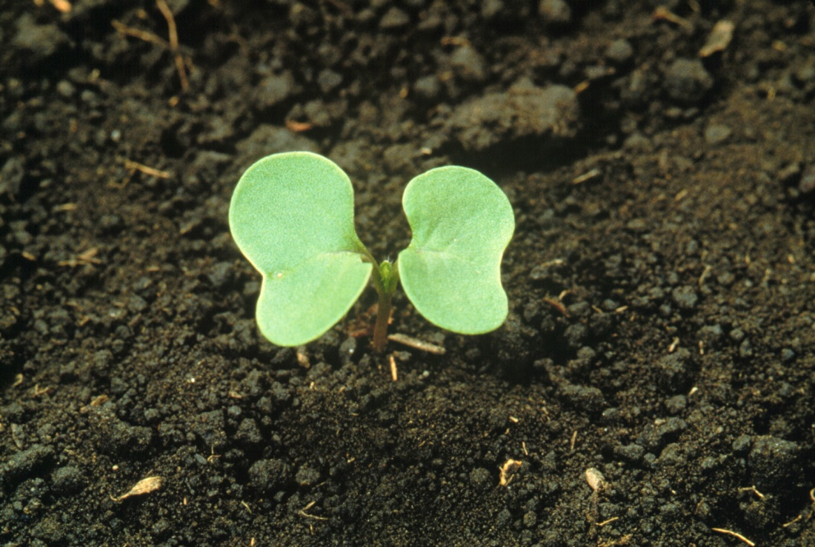
Seedling Establishment
Minimal energy stored in small seed
Requires moisture to emerge and establish quickly
Reduce the number of factors that limit emergence

Slide 7
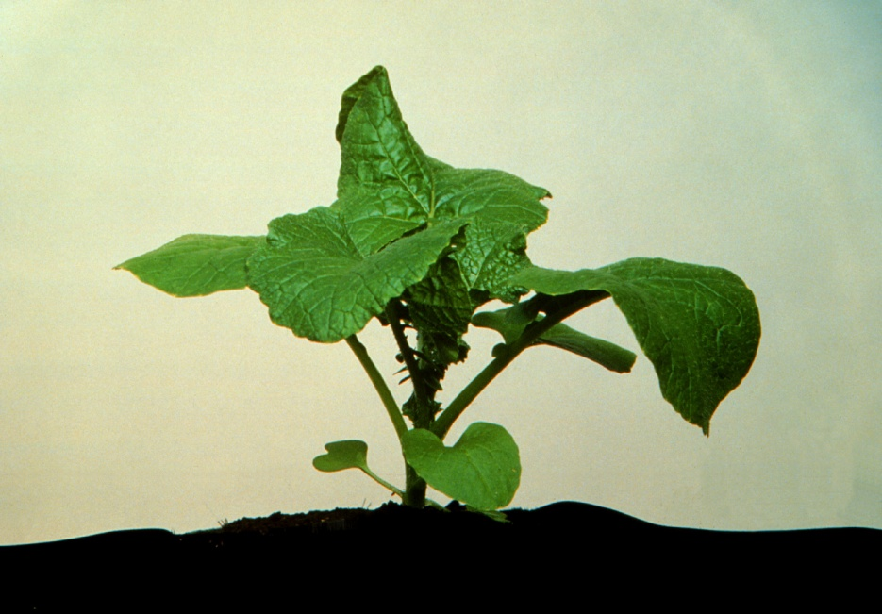
Rosette
At rosette stage, canola is most tolerant to freeze damage
To increase chances of winter survival, canola must reach the 5-8 leaf stage
Can out-compete most annual weeds at rosette stage

Slide 8
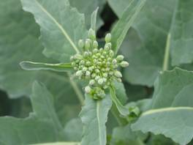
Bolting
Stem elongation begins and flower parts are visible at the center of the rosette
Buds at the base of the raceme open first as new buds form at the top
A light frost will kill only those buds which opened that day

Slide 9
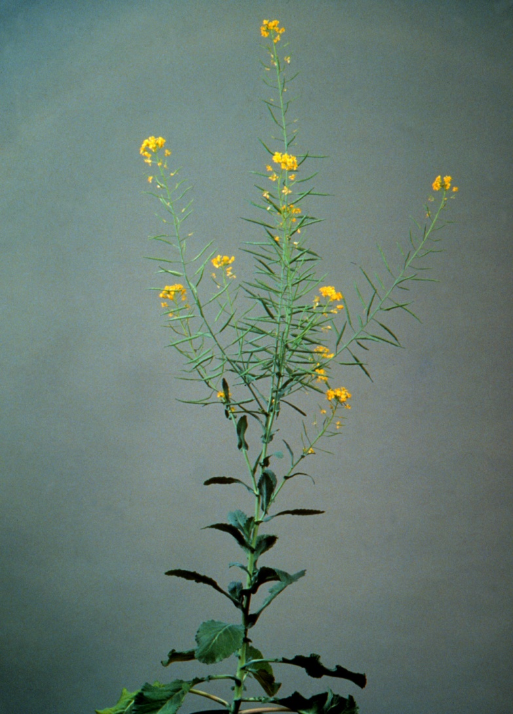
Flowering
Indeterminate crop
Reaches 60% of total height before flowering
Stem continues to elongate during flowering
Flowers for 2-3 weeks
Indeterminate nature provides some built in resistance to stresses at flowering

Slide 10
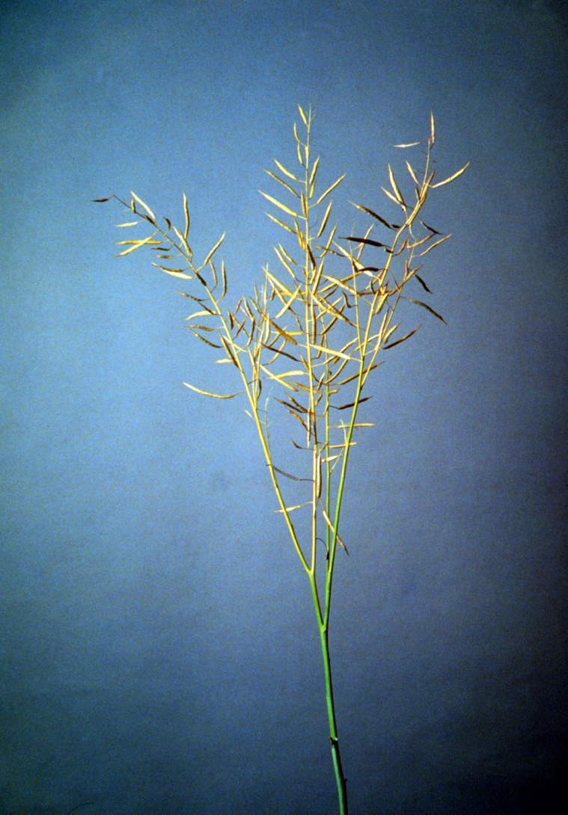
Ripening/Maturity
Canola has a narrow harvest window
After 7 days dramatically increase the risk of pre-harvest shattering
Physiological maturity reached at 40% moisture
Grain loses moisture at a rate of 2-3% per day

Slide 11
Seedling Establishment
Very critical time period
Several factors affect establishment
  Lack of soil moisture
  Soil compaction
  Water-logged soils
  Crusting
  Deep furrows
  Crop residue

Slide 12
Establishment cont.
Fine, medium-textured soils that do not pond
Moist, firm seedbed for optimal seed-to-soil contact
Plant at 1/2” - 1” depth
Use grain drill at preferred spacing with disk openers
Soil pH should be between 6.0 and 7.0; below 5.8 could limit yield
Be aware of herbicide carryover!

Slide 13
Rotational Restrictions of Commonly Used Herbicides
Herbicide | Restrictions for planting canola
Ally | pH<6.5, 10 mon.; pH>6.5, 18 mon.
Amber | >4 months
Atrazine | 2nd fall following application
Beyond/Raptor | 18 months
Dual/Frontier | 18 months
Express | 60 days
Finesse | 14 to 18 months
Glean | 18 months
Harmony Extra | 60 days
Maverick | 10 to 14 months
Olympus | Field bioassay required
Osprey | 10 months
Trade names are used to identify products. No endorsement is intended, nor is any criticism implied of similar products not named.

Slide 14
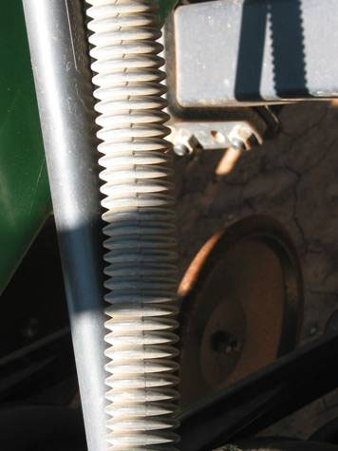
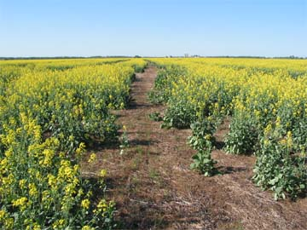
Planting Tips
Small seed can hang up in flex tubes
Important to keep furrow openings clean of residue!

Slide 15
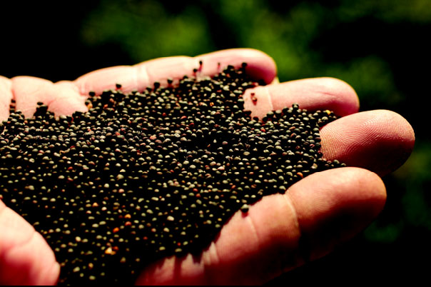
Seeding Rate
100,000 – 125,000 seeds/lb
Recommend 5 lbs/a which yields ~13 seedlings/ft²
1 seedling/ft² sufficient due to branching effect
Plant ~6 weeks before the first killing frost

Slide 16
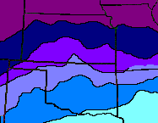
Planting Dates
8/24 – 9/6
8/28 – 9/10
9/7 – 9/20
9/15 – 9/25
9/20 – 10/5
9/25 – 10/5

Slide 17
Improving Fall/Spring Stands
Too much fall growth results in reduced moisture availability and a high growing point
Too little fall growth results in low CHO reserves and a high risk of winter kill
Increase seeding rate by 1 lb/week for each week beyond the optimum planting date and vice versa
No-till issues

Slide 18
Final fall stands and winter survival for Noble County, Oklahoma locations.
 | Site A |  |  |  | Site B
Treatments | Final Fall Stands | Winter Survival | Decrease |  | Final Fall Stands | Winter Survival | Decrease
 | - - - plants/ft² - - - |  | - - - % - - - |  | - - - plants/ft² - - - |  | - - - % - - -
Conventional Till | 1.7bc | 1.7b | 0.0a |  | 4.9b | 4.1b | 0.17a
NT Burn | 1.5c | 1.2b | 0.2a |  | 3.4b | 2.8bc | 0.17a
NT | 1.0a | 0.8b | 0.2a |  | 3.5b | 2.6bc | 0.24a
NT - 2x Residue | 2.6bc | 1.4b | 0.5a |  | 2.7b | 0.9c | 0.67a
NT No Residue | 4.2a | 3.9a | 0.1a |  | 8.8a | 6.3a | 0.28a

Slide 19
Average winter canola grain yield at Lake Carl Blackwell in 2008.
Treatment No. | Seeder | Spacing | Residue Management |  | Tillage | Yield
 |  |  |  |  |  | - lb/ac -
1 | Drill | 7.5 | coulter |  | no till | 1766
2 | Drill | 7.5 | none |  | no till | 1920
3 | Drill | 7.5 | none |  | tilled | 1828
4 | Drill | 15 | coulter |  | no till | 2101
5 | Drill | 15 | none |  | no till | 2021
6 | Planter | 15 | none |  | no till | 2889
7 | Planter | 15 | row cleaner |  | no till | 2490

Slide 20
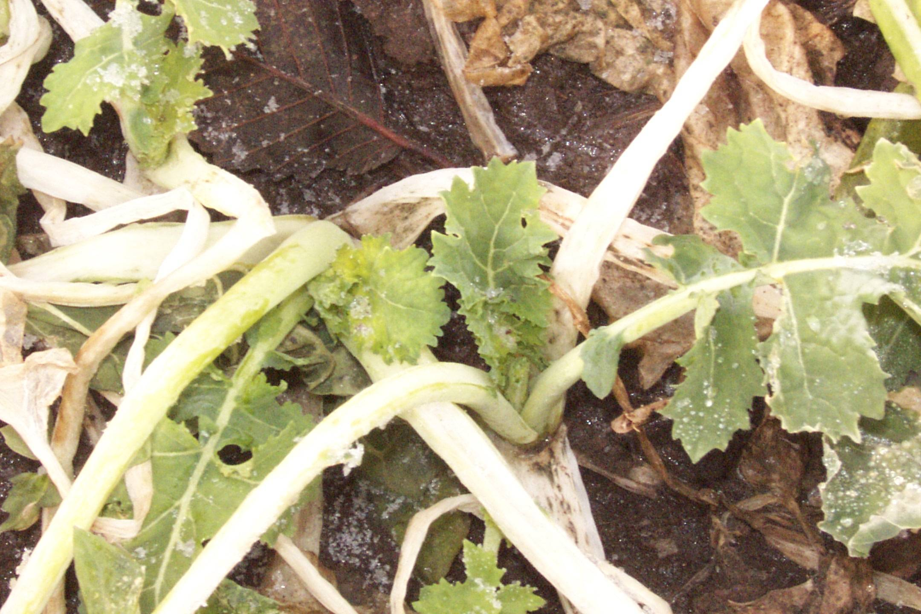
Growing Point

Slide 21
Fertility
30% more N than wheat
5 lbs. soil + fertilizer N per 100 lbs expected yield still seem appropriate.
  1/3 N pre-plant and 2/3 N top-dressed
P & K recommendations very similar to wheat
0.60 lb S/bushel of yield
Use a S containing fertilizer rather than elemental S

Slide 22
Weed Management
Canola a member of the mustard family and related to common weeds such as blue mustard, shepherd’s purse, and peppergrass
With good management practices, canola can out-compete most annual weeds
Treflan pre-plant applied at ½ to 1 lb ai per acre for broadleaf control
Poast, Assure II, and Select 2 EC for grass control in the late fall or early spring
Good control of grassy weed species if label directions followed
Trade names are used to identify products. No endorsement is intended, nor is any criticism implied of similar products not named.

Slide 23
Insect Management
Common insects in the southern Great Plains include grasshoppers, cutworms, and aphids
Grasshoppers can be a significant problem at emergence
Aphids colonize the terminal buds
Other potential pests include: cabbage seed pod weevil, flea beetles, wireworms, cabbage aphids, diamondback moths, and cabbage root maggot
Seed treatment is a no-brainer

Slide 24
Disease Management
As acres increase, disease pressures increase
Most common diseases are white molds (Schlerotinia spp.), Aster yellows, and damping off (Pythium spp.) fungi
Black leg (L. maculans) is common worldwide and the most serious threat to production
Crop rotations are the best preventative solution!
  Common fungi spread through infected seed, stubble, and spores

Slide 25
Harvest
Canola must be harvested when it is ready!
Swathing vs. Direct cut
Follow combine settings in owner’s manual for rapeseed
Average seed moisture should be 8-10% with no green seed visible

Slide 26
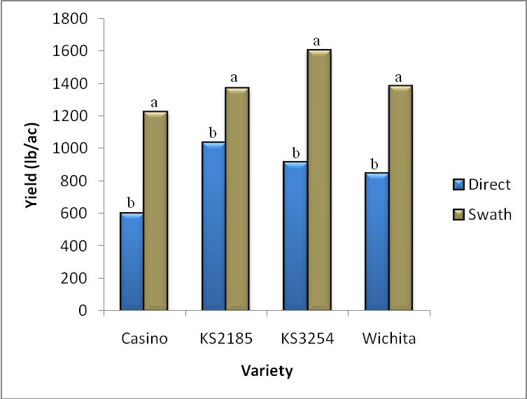
Swath vs. Direct

Slide 27
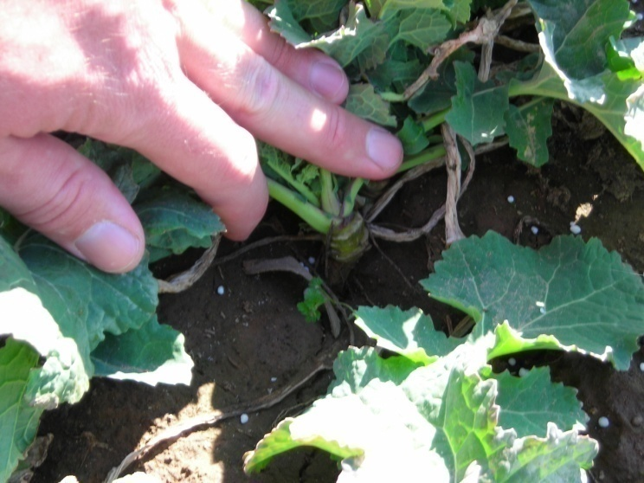
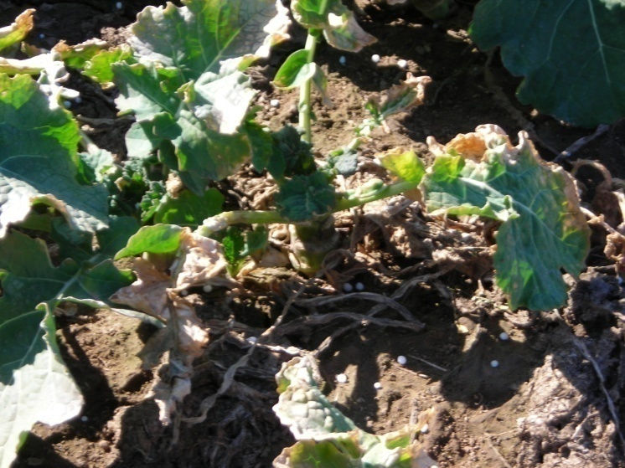
Making an informed decision
Yield
Winter survival
  Crown height
Purpose of planting canola
  Weed pressure
  Pest
Shatter and lodging
Wichita
TCI.06.M2

Slide 28
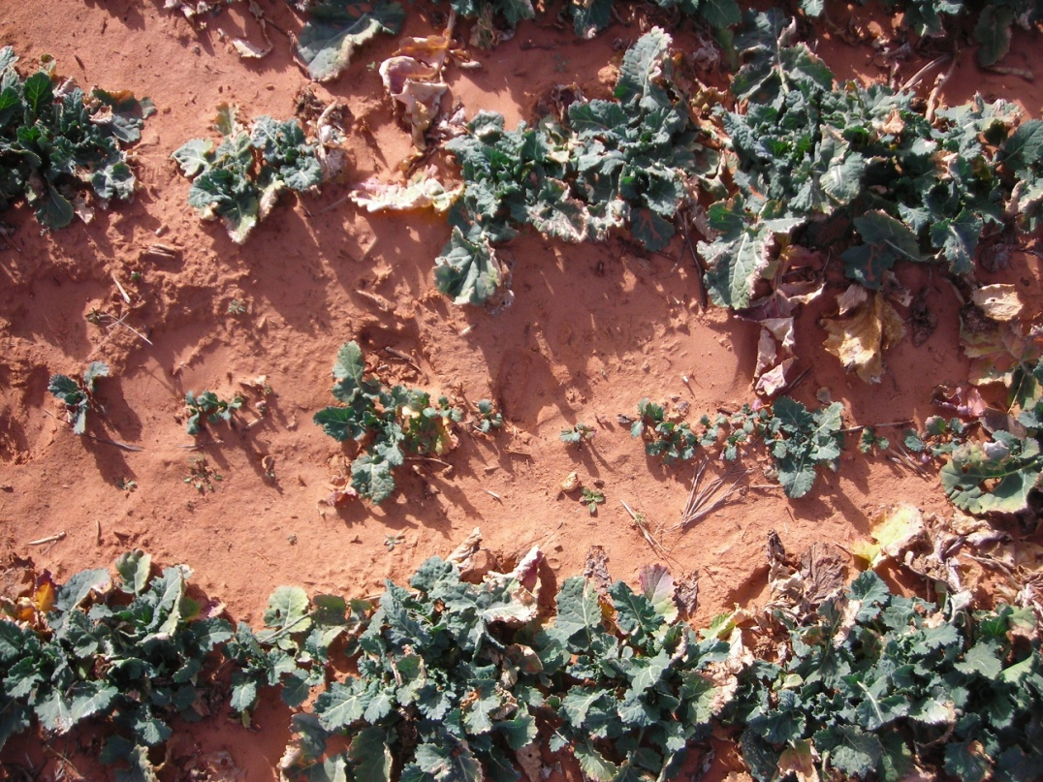
Variety Trials 2006-2007
16 Entries
Rated for:
  fall stands
  winter survival
  lodging
  shattering
5’ x 20’ plots
5 replications

Slide 29
Altus Yield 2005-2006
Mean = 1146 lb/ac
LSD = 253 lb/ac

Slide 30
Altus Yield 2006-2007
Mean = 3486 lb/ac
LSD = 430 lb/ac

Slide 31
Tipton Yield 2007-2008
Mean = 2324 lb/ac
LSD = 640 lb/ac

Slide 32
Summary
Winter canola works.
Be flexible.
Choose a variety that fits your management strategy.

Slide 33
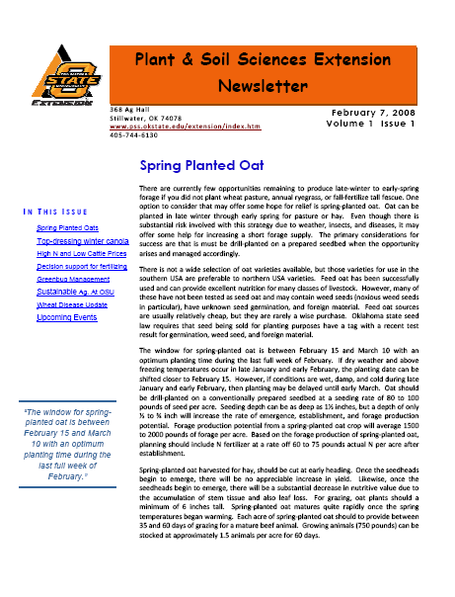
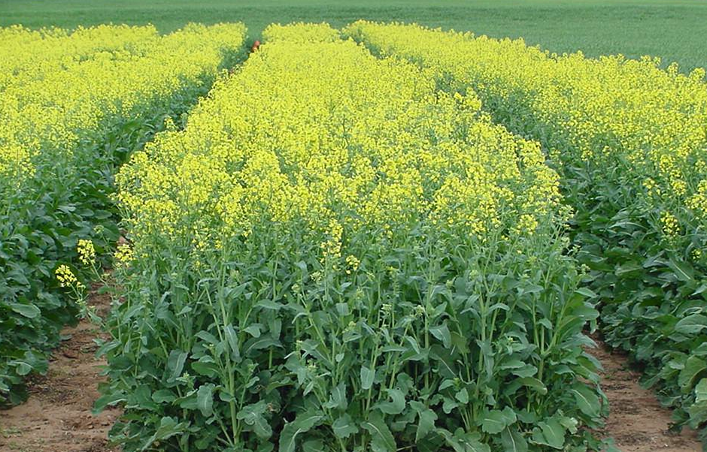
Thank You
Chad Godsey
Tel: 405-744-3389
Email: chad.godsey@okstate.edu

