Slide 1
Survey results for Troublesome weeds and disease in peanut fields
Survey conducted by
Emi Kimura
Extension Agronomist and State Extension Peanut Specialist
AgriLife Extension Vernon, TX
WTACI, September 14, 2022

Slide 2
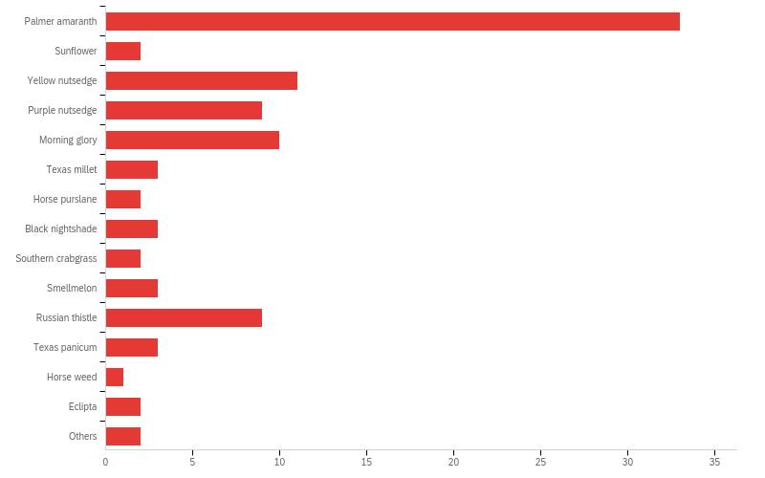
Q1 - Select the most troublesome weeds in your peanut fields

Slide 3
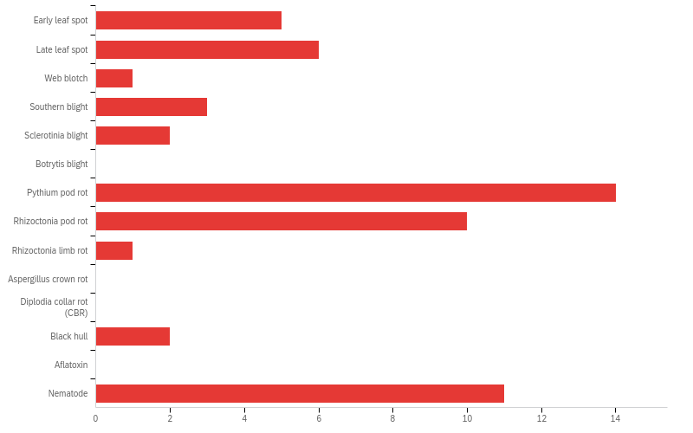
Q6 - Select the most troublesome diseases and nematode in your peanut fields

